Slide 1
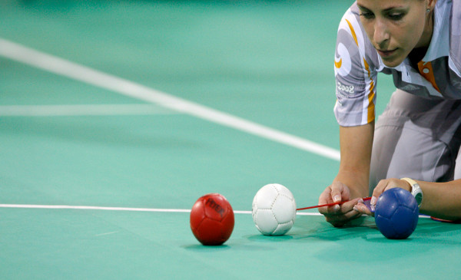
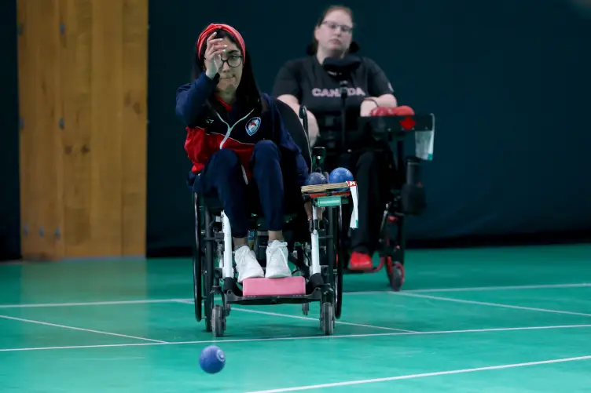
Make a difference and volunteer with Halifax Boccia! Volunteers Needed on Saturdays for 2 hours per week
Halifax Boccia and the LeBrun Recreation Centre are looking for people who want to make a difference by volunteering with the exciting Parasport of Boccia!
Volunteer Orientation
Beginning on September 28th, 2:00pm to 4:00pm Boccia will be offered for eight-weeks at the LeBrun Centre
Reach out to us about volunteer orientation
***All volunteers must agree to undergo a vulnerable sector and criminal records check
The commitment:
We are looking for volunteers to help with
Set up and take down
Assisting our Lead Volunteers with refereeing games, practice activities and drills
2 hours per week for 8 weeks
For information on volunteer orientation email Sharon at Osprey859@gmail.com
A little bit about the sport of Boccia
Boccia is a Parasport that can be played by anyone with a physical disability or mobility challenge.
It is played recreationally and competitively.
Boccia is a co-ed sport, similar to curling or lawn bowling, it can be played one on one, in teams of three, or in pairs.
Boccia is played indoors, on a court that is similar in size to a badminton court
For more information about the sport of Boccia go to bocciacanada.ca
Boccia Program
An eight-week Boccia program will be offered on Saturday afternoons at the LeBrun Centre, starting September 28th. 2:00pm to 4:00pm program will be offered to participants ages 13 years and up.

